Slide 1
MY SCHOOL IS MY CASTLE!

Slide 2
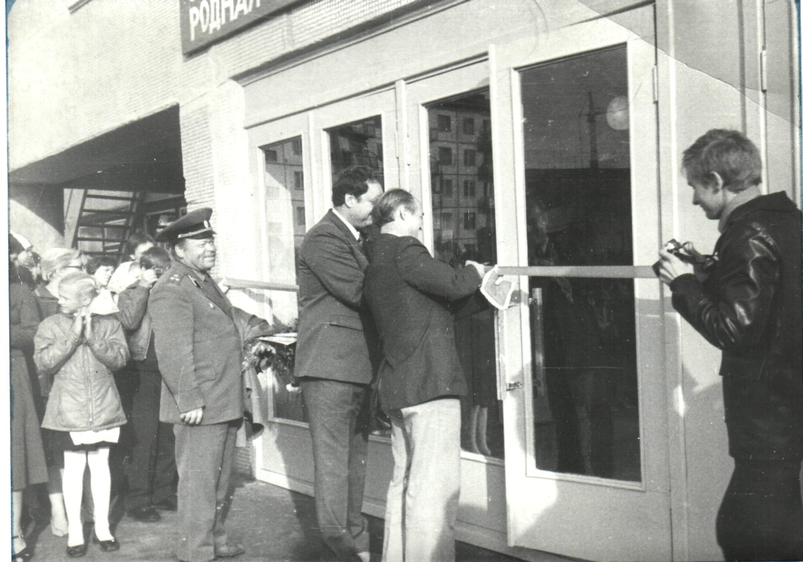
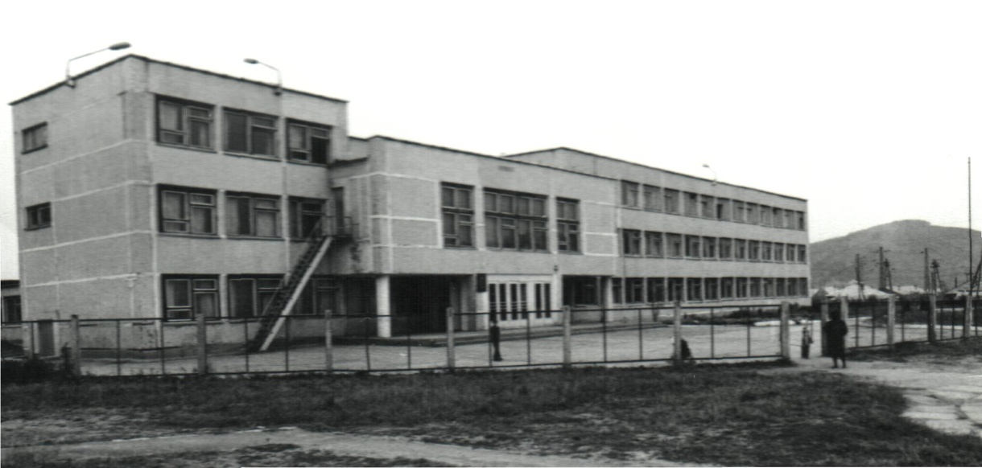
In 1984 a new modern building of our school was built. About 620 pupils got the opportunity to study there.

Slide 3
Nowdays our school is spacious, airy and light. There are 3 floors in it. There is a large schoolyard and a stadium around the school.

Slide 4
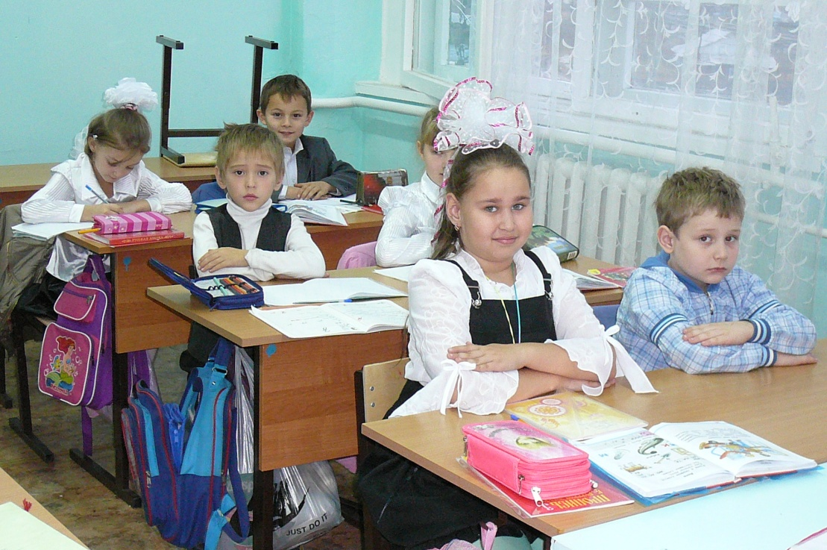
On the second floor there are the classrooms only for the primary- school pupils. Junior schoolchildren study there.

Slide 5
There are many classrooms in the school. Some of them are supplied with a modern equipment which helps to study different subjects better. The classrooms have TV sets that are used at the lessons.

Slide 6
Each lesson in our school is a mini-performance: different presentations, interesting experiments, exciting teachers’ stories and pupils’ discussions. For such lessons we should thank our teachers - the fairest, kindest, cleverest and most sociable people.

Slide 7
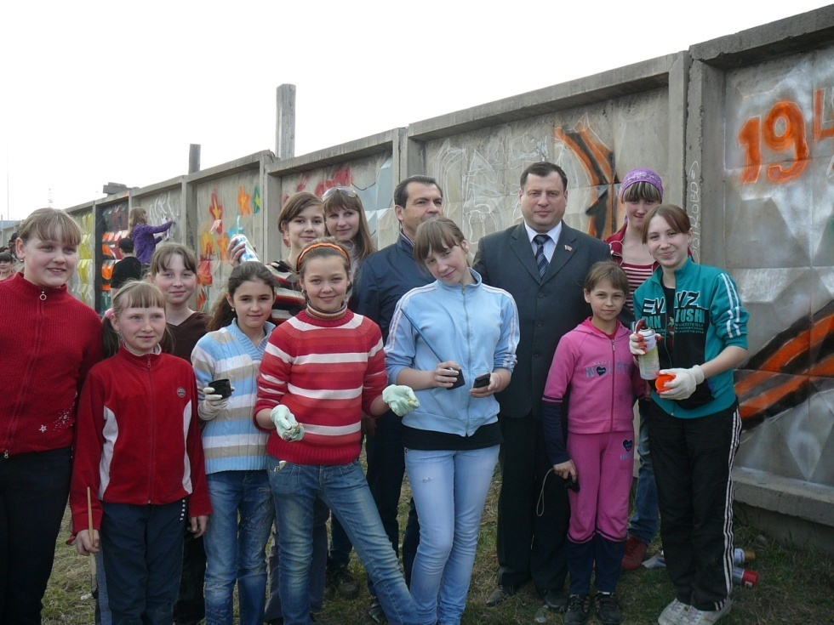
We have not only lessons at school. Different events take place before, after and during the classes: concerts in connection with different holidays, children’s parties, sport competitions, Olympiads, contests.

Slide 8
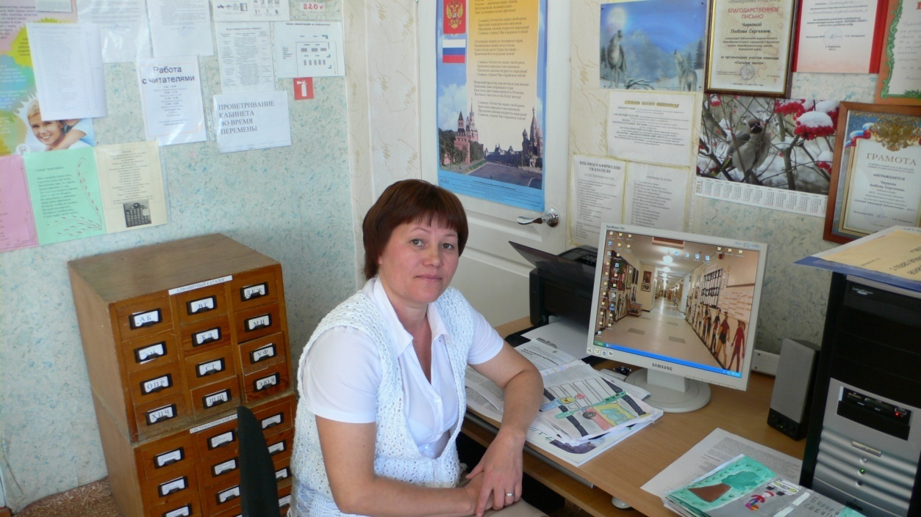
There is a library on the ground floor of the school building. There are a lot of old and new books there. You can take any book you want.

Slide 9
There is a dining room. It is on the ground floor too. Here pupils and teachers have their breakfast and dinner. The dining-room is very clean and has beautifully designed interior. There are many nice pictures and flowers on the walls.

Slide 10
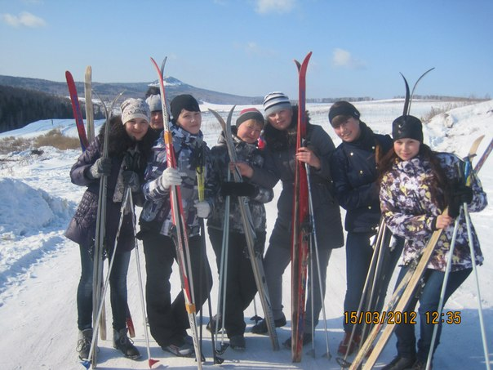
There is also a gymnasium near the dining-room. All pupils like to attend it because at our physical training lessons we usually play exciting sport games and have a lot of fun.

Slide 11
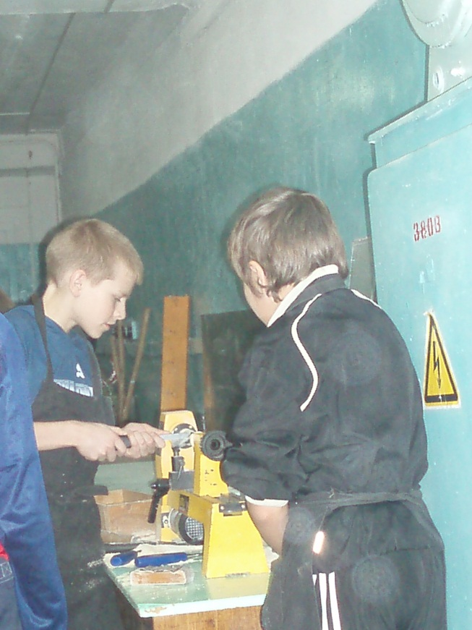
.And there is a room for girls to learn housekeeping and craft work. It is also on the ground floor. The boys of our school have a woodwork room too. There are all kinds of tools and machines in the workshops.

Slide 12
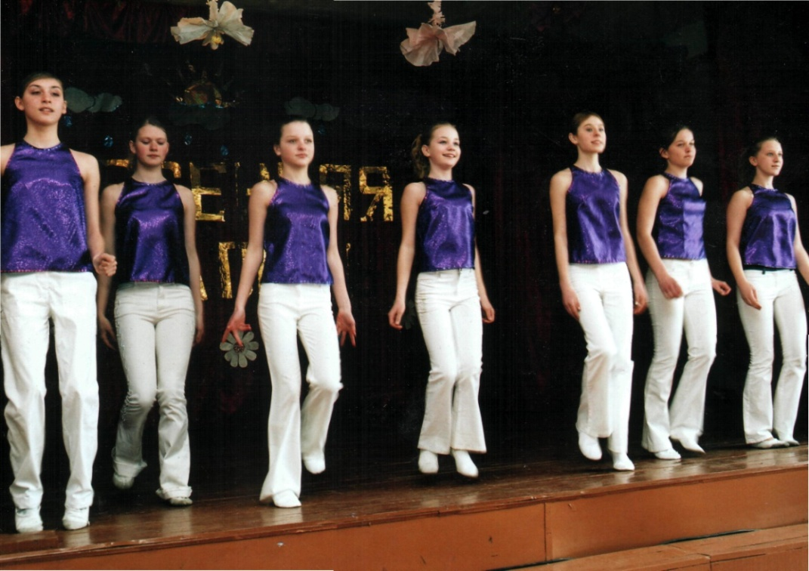
There is a school conference hall on the first floor where meetings, conference and school dancing parties take place. School theatre once in two or three months performs its plays here. The most remarkable event of the school life –”The Last Bell” is also celebrated here.

Slide 13
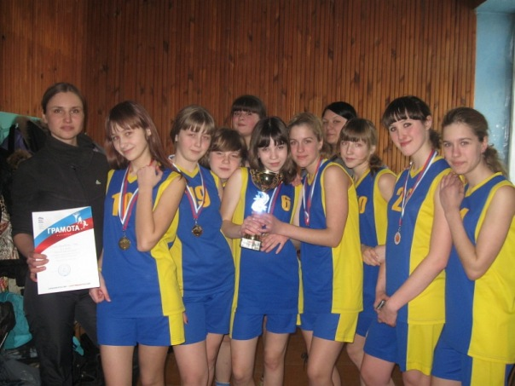
After classes many pupils don’t go home right away. We have choir, dancing club and sports club. Some pupils attend a musical school.

Slide 14
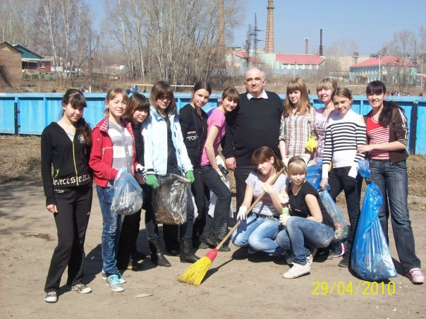
Our school is our castle. That`s why we take care of it. We do our best to make it clean and beautiful.

Slide 15
When I think about my school I don't remember its walls and desks; it is my teachers and school-mates who will be always with me.
We are so thankful to our teachers for what they have done for us.

Slide 16
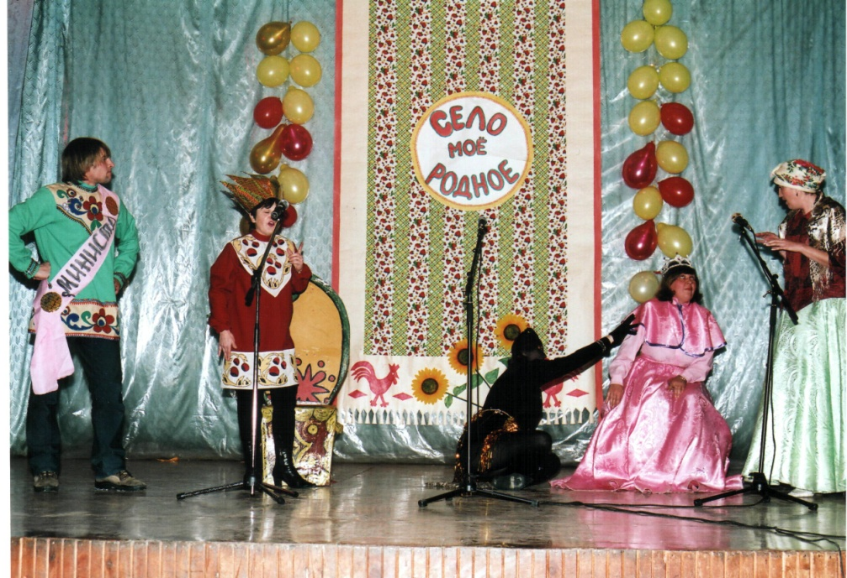
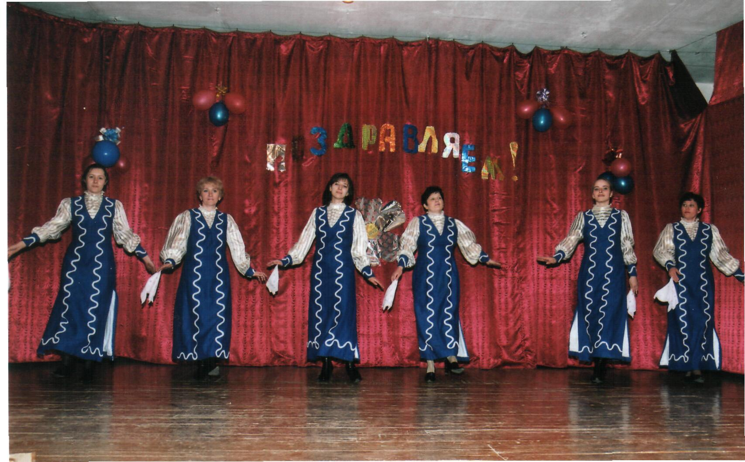
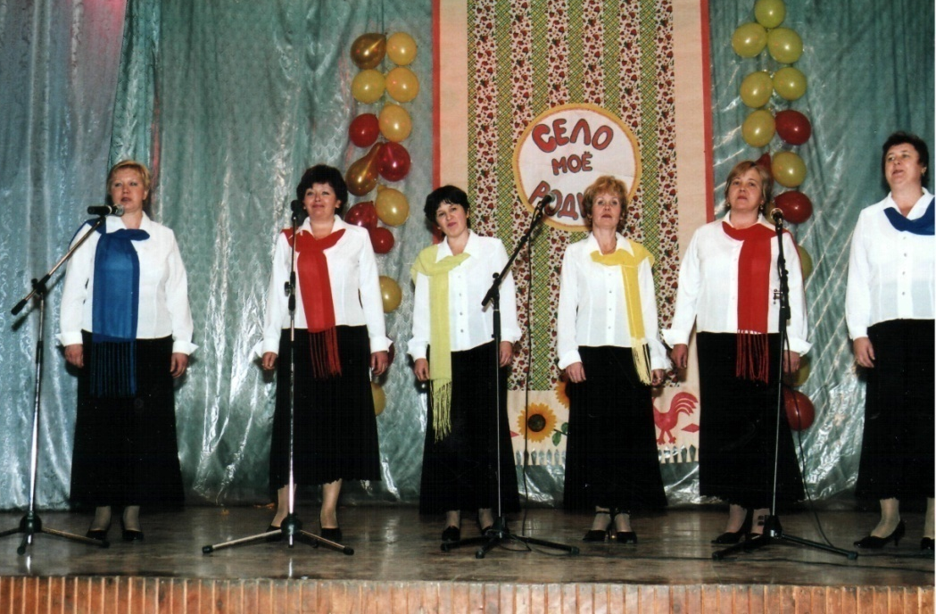
If you look at my school, you can think: “A typical school! There are millions of such schools everywhere.” No, my school is the best in the world
Also we are proud of our teachers who are full of energy, optimism and wisdom.

Slide 17
We study at the best school in the world. Each pupil of our school thinks so. Here is an atmosphere of friendship and understanding, so we go to school with pleasure. If you look at our school, you can think: “A typical school! There are millions of such schools everywhere.” No, our school is the best in the world.

Slide 18
THANKS FOR ATTENTION!

